Slide 1
Reinforcement Learning
What? Even more intense learning?

Slide 2
Flow
Limits of “traditional” learning methods
Reinforcement Learning
Example
References
Q&A
Notes:
Limits of Traditional Learning methodologies: Supervised vs Unsupervised
Talk about RL: What is the intuition behind it, and key concepts.
Talk about applications of RL, and dive into an example
References
Q&A

Slide 3
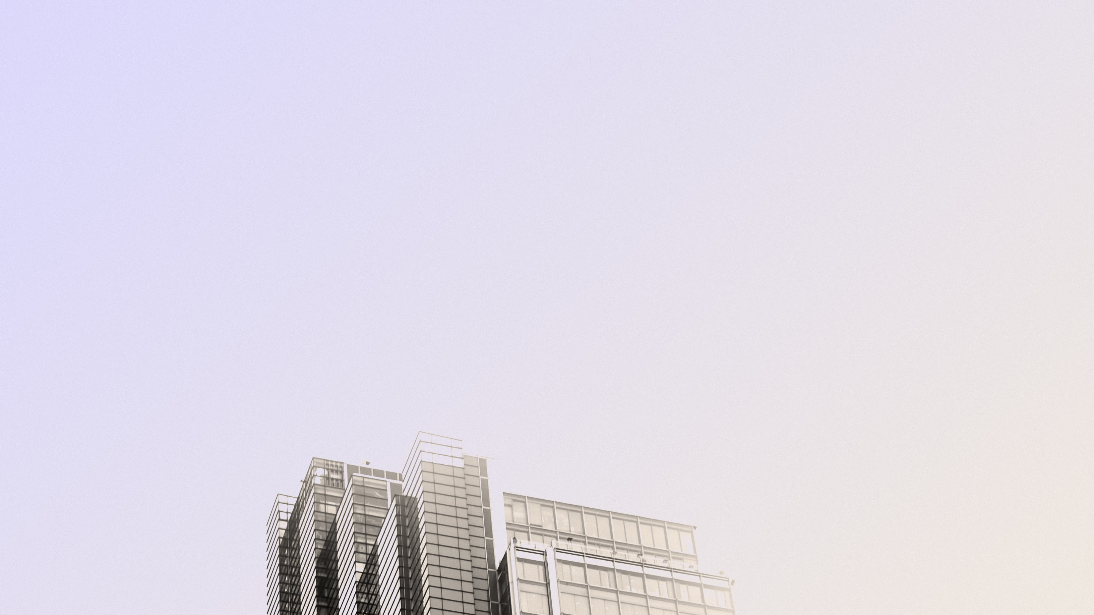
Limits of “traditional” ML models

Slide 4

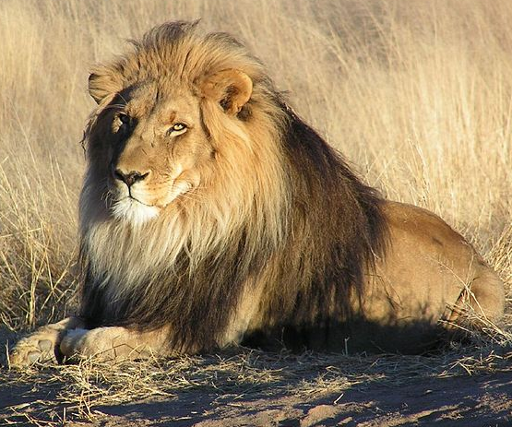
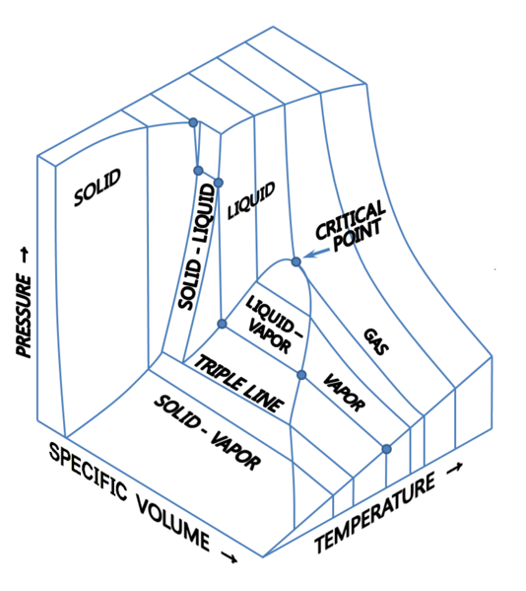
“Traditional” machine learning
Supervised learning
Labelling is known
Classification: Is this a cat
Regression: How much liquid will there be if a fluid is at temperature V, pressure P and volume V?
Unsupervised learning
Labelling is not known
Clustering: What looks like this?
Dimensional reduction: Eliminate redundant features
Notes:
Supervised Learning is for known labels
Let’s say I have a picture. Is this picture of a cat?
Regression: Have you boiled water? Temperature and Volume. How much has turned into vapour?
Unsupervised Learning:
Cat -> How close is it to other pictures?
Reducing dimension by mapping functio

Slide 5
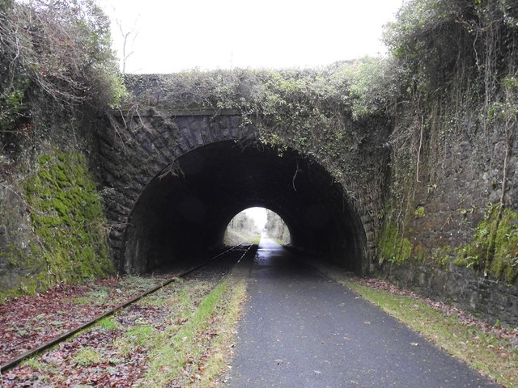
slalom.com
Notes:
Bob receives a phone call, and does not get good coverage.
He’s inside a tunnel, what does he do?
a) He can change phone plans
b) Look for a better location
Traditional: The location he is in does not have coverage -> Does not help him a lot
What would Bob do without ML? He will test out different locations until he finds coverage
Neither workl intuitively uses how children work

Slide 6
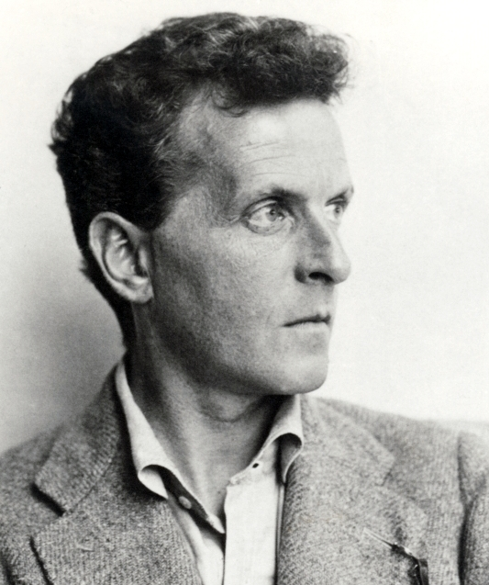
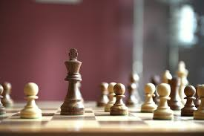
Where do supervised/unsupervised fail
No true decision making capability
Exponentially harder
Describing vs interacting
Going from 85 to 88% accuracy is harder than 70 to 85%
Reiteration of the Data Scientist cycle
At what point is the effort of finding features redundant?
Features are descriptors
Can you describe anything without feeling that you are missing key points?
Ironically, traditional ML fails at one thing humans excel at: interacting
Rarely gives a best possible outcome
Gives you insight on a problem, but cannot give you a path to optimality
Notes:
-> Traditional Machine Learning can, in rare instances, give you true decision making capabilities
-> At what point does exhaustive description of the environment become redundant? Where does the granularity and the features that needs to be used not redundant?
-> There is always going to some crucial information that is missing when we capture information (Wittgenstein)
-> Using traditional ML we are inherently doing some dimensional reduction: reducing the environment into a description
-> Ironically, it fails at something humans do all the time: interact with an environment

Slide 7
Reinforcement Learning

Slide 8
Reinforcement Learning
Agent
Agent interacting with an environment
Maximize the reward long-term to achieve a goal
Receives Rewards
Takes action
Environment
Notes:
Agent interaction with an environment through an actions and rewards.
The agent takes an action, the environment gives something back. Depending on the reward it gets, the agent will perform another action.
By convention, rewards are negative

Slide 9
Terminology
State (s): Description of where the agent is
Action (a): Agent’s decision
Policy (π): Sequence of actions
Greedy: Sequence of actions that provides the highest short-term reward
Optimal (π*): Sequence of actions that provides the highest long-term reward
Discount factor (γ): How much does the long-term reward affect my current reward?
Notes:
State: Where you are in the world
Action: What am I going to do?
Policy: Sequence of actions
Greedy: Short term reward
Optimal: Long term reward
Discount factor: How long term will affect reward (decay)

Slide 10
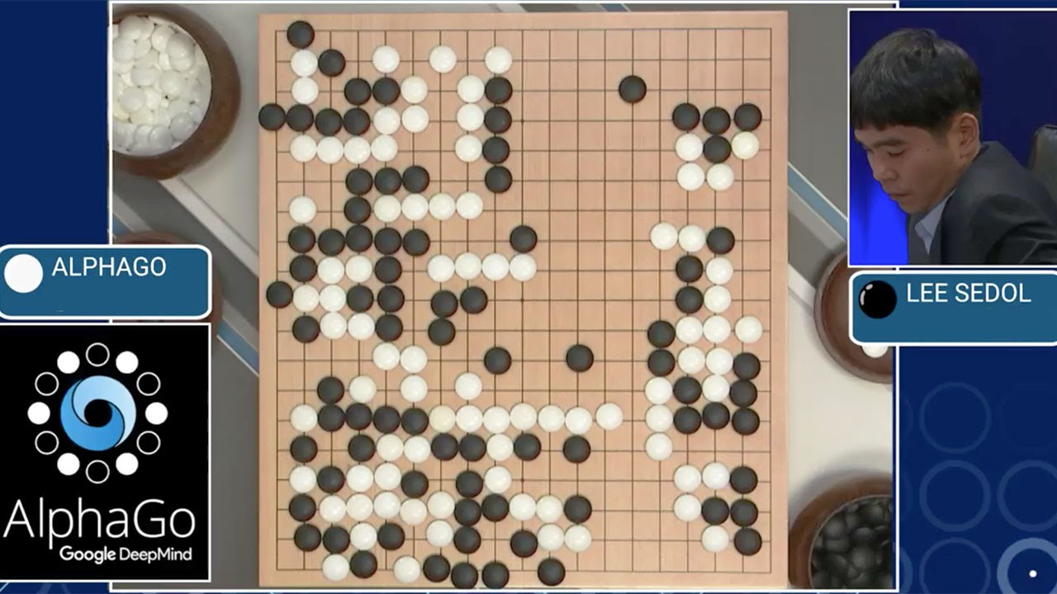
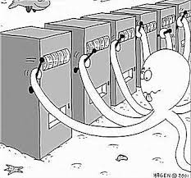
Areas of research
Gaming
Resource allocation
Other
AlphaGo (Go)
AlphaZero (Chess)
SC2LE (StarCraft)
How should I split my revenue among different departments?
How can my company allocate resources more efficiently?
Healthcare providers
Advertisement
Traffic controlling
Self-driving cars
Robotics
Notes:
Where can RL expected to be used?
-> Games: Designing better AI systems.
-> Resource allocation: How to allocate resources according to the situation you are in
-> Healthcare: Personalized doctor allocation
-> Advertisement: what to show and not show? What colors?
-> Traffic control: During rush hour, how to change traffic light times?
-> Self-driving cars: How should I turn the steering wheel?
-> Robotics: How can I lift this block?
FOCUS: STILL IN ITS INFANCY,

Slide 11
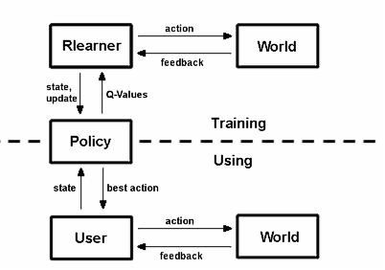
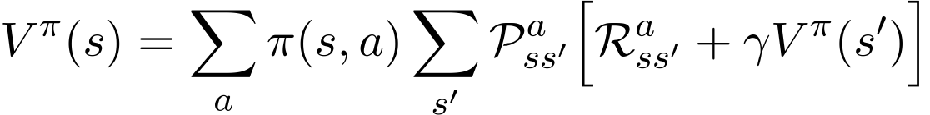
Methodology
Agent
Environment
Define environment
Understand whether state space is defined (Partial or not), Deterministic or Stochastic
What is the action space
What algorithm to use (Qlearning, DeepQLearning, etc)
Explore state space
Take action, and interact with the environment
Update the algorithm by using Bellman’s equation
Decay the greedy policy (go from exploration to exploitation)
Agent
Environment
Notes:
Define environment
Much like Traditional Machine Learning, we need to understand what we are dealing with:
Partially observable or observable environment (MDP vs POMDP)
Sometimes you might not know where you are in the world, so the level of complexity increases (playing Chrss blindfolded)
What actions are possible: setting up nodes
What algorithm to use depends on the how complex the environment is

Slide 12
Example

Slide 13
Reinforcement Learning theory course (David Silver)
https://www.youtube.com/watch?v=2pWv7GOvuf0&list=PLzuuYNsE1EZAXYR4FJ75jcJseBmo4KQ9-
Reinforcement Learning in Python (Sentdex)
https://www.youtube.com/watch?v=yMk_XtIEzH8&list=PLQVvvaa0QuDezJFIOU5wDdfy4e9vdnx-7
References
Reinforcement Learning and its relationship to Supervised Learning
https://pdfs.semanticscholar.org/ccec/df227475db9be6f0fa8f431c1db51e9dcd83.pdf
Exploration vs Exploitation (Russ Salakhutdinov)
http://www.cs.cmu.edu/~rsalakhu/10703/Lecture_Exploration.pdf
AWS DeepRacer
https://www.youtube.com/watch?v=Z_L3EVTV6xQ
Gym Environment
http://gym.openai.com/docs/
AlphaGo: Move 37
https://www.youtube.com/watch?v=HT-UZkiOLv8
Mario Kart RL
https://www.youtube.com/watch?v=Tnu4O_xEmVk

